Slide 1
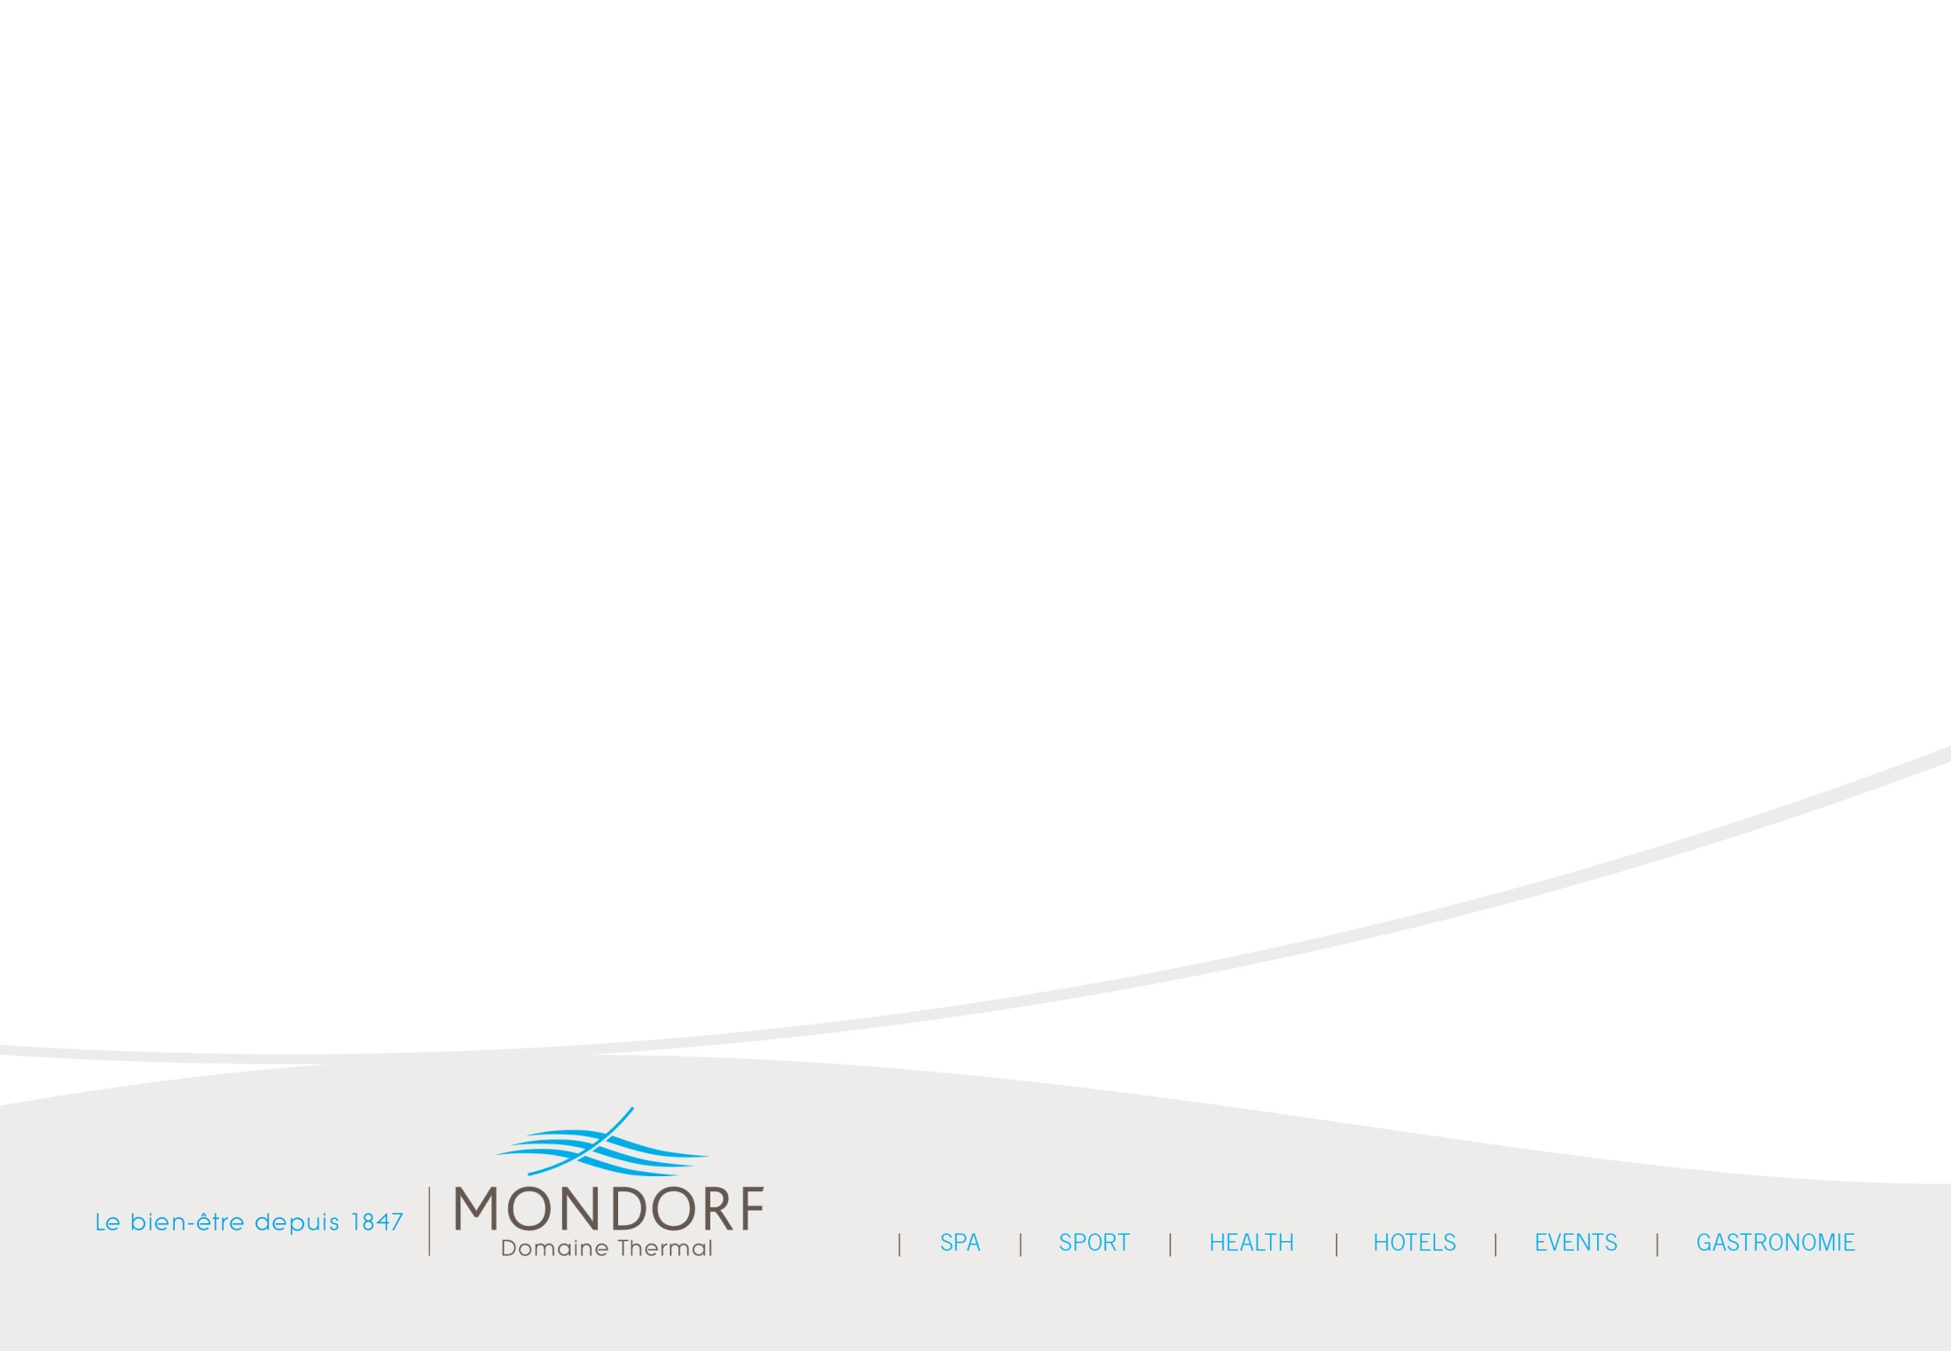
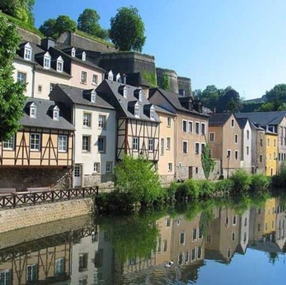
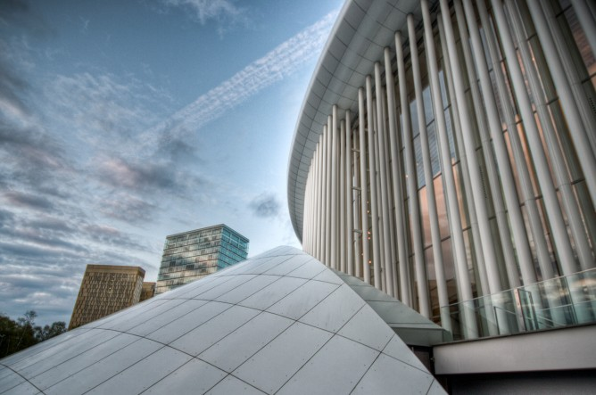
Why Luxembourg?

Slide 2
Why Luxembourg?
situated in the heart of Europe
easily accessible with daily direct flights from major European cities
daily long haul connecting flights via major European hubs: London/Heathrow, Frankfurt/Main & Paris/Charles de Gaulle
High speed TGV direct trains from Paris
human dimension, no distances
high-quality infrastructure in hospitality
perfectly safe
a hidden treasure & unknown European capital
fascinating nature
a multicultural and multilingual country
a real local identity with regional specialities

Slide 3
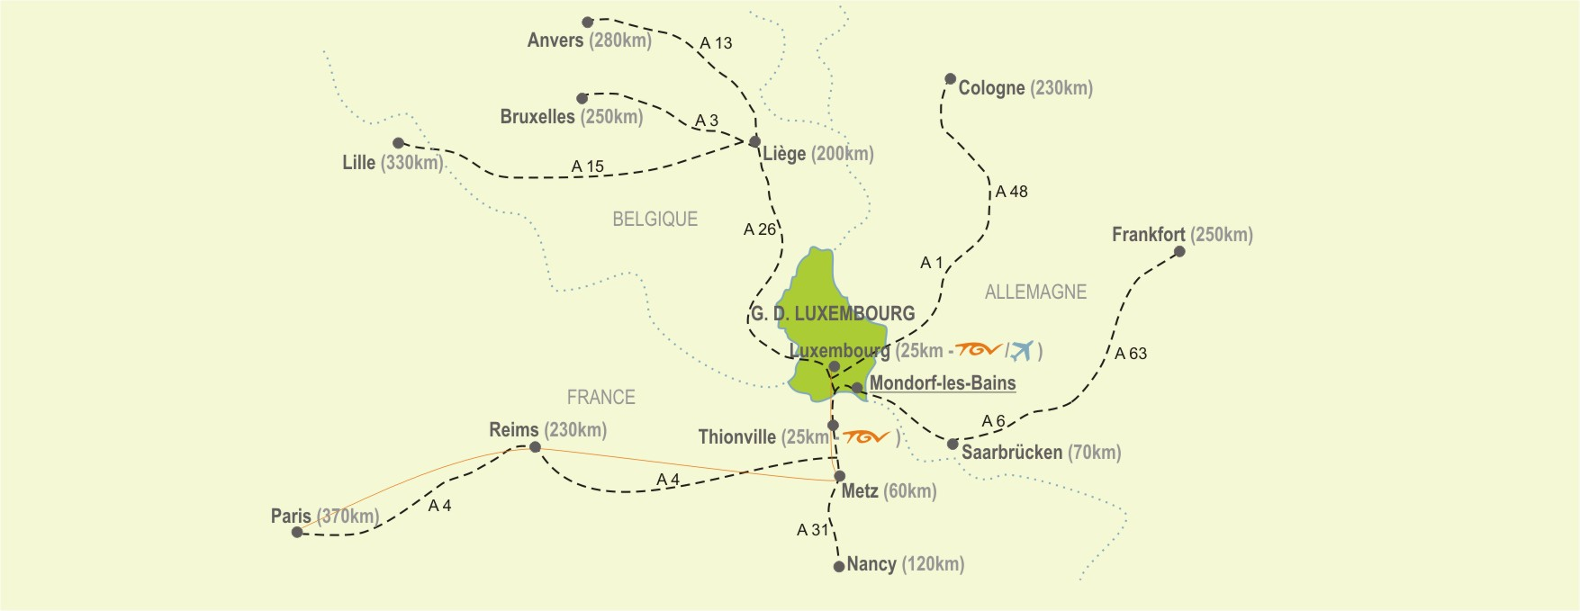
Why Luxembourg?

Slide 4
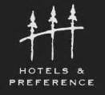
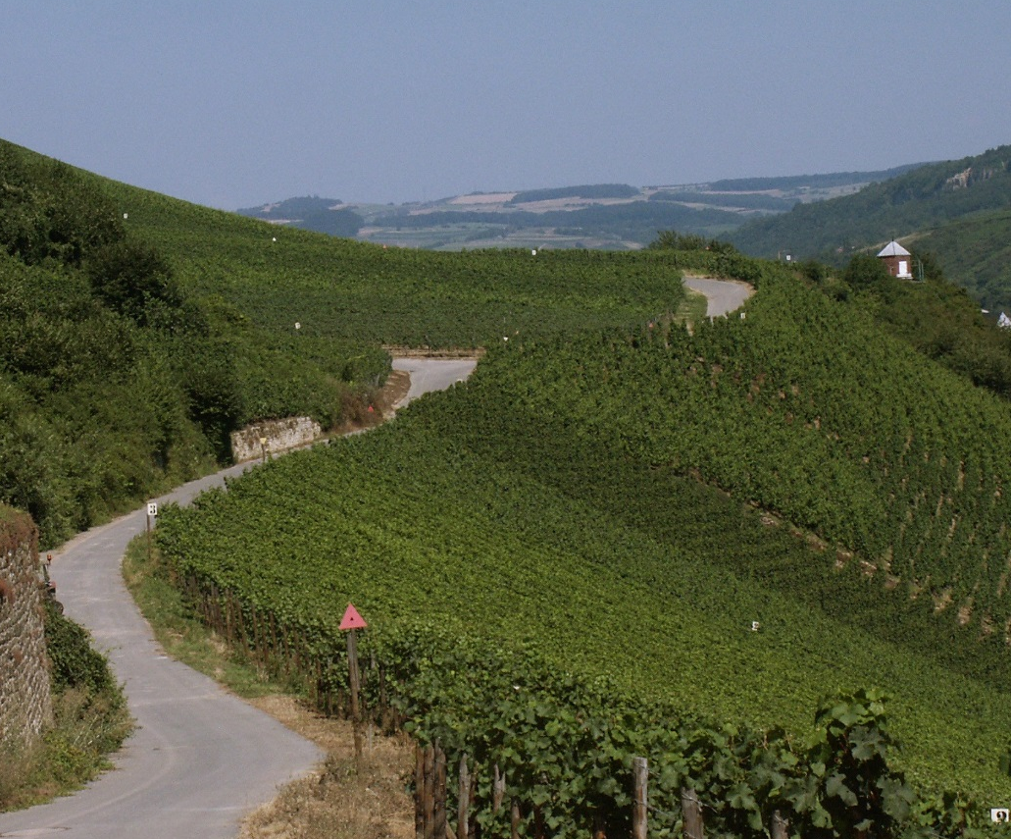
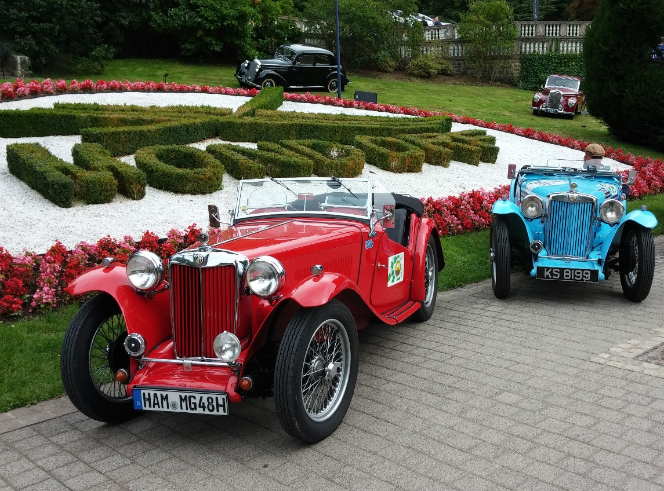
Why MONDORF Parc Hotel**** Conference & Spa ?

Slide 5
Why MONDORF Parc Hotel**** Conference & Spa ?
easily accessible from Luxembourg Findel Airport – 24 km
situated in the picturesque Moselle region
a few minutes away from the city of Luxembourg – 18 km
large parking facilities
perfect and varied drive test routes
quite & green surrinding
spa & conference hotel with optimal capacity of 108 rooms
contemporary design style with full range of modern amenities
fully refurbished in 2015
15 function rooms with capacity up to 350 delegates & including state of the art technology
first class and full range catering services created by Chef Gilles Goess

Slide 6
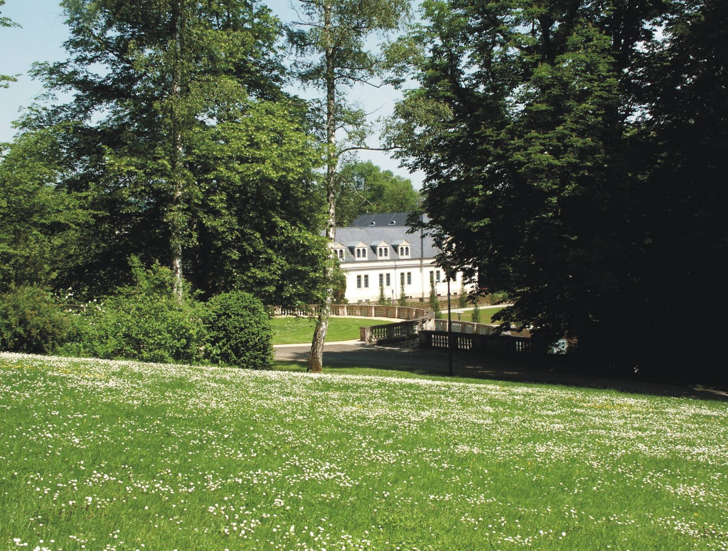
Mondorf Parc Hotel, nestling elegantly in a beautiful parkland,
is the ideal venue for your next event.

Slide 7
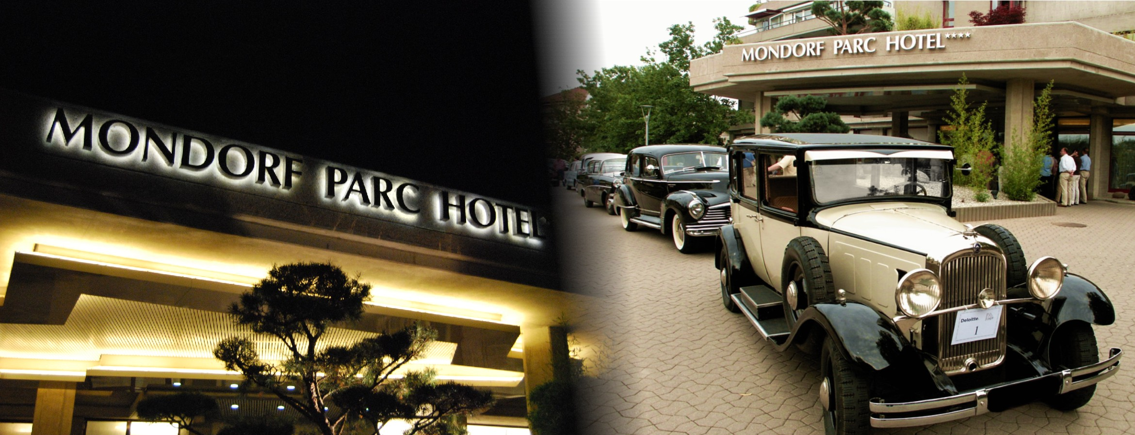
Ideally located close to the Moselle vineyards and a few minutes away from the city of Luxembourg our property offers easy access (air, high-speed train TGV and motorways)

Slide 8
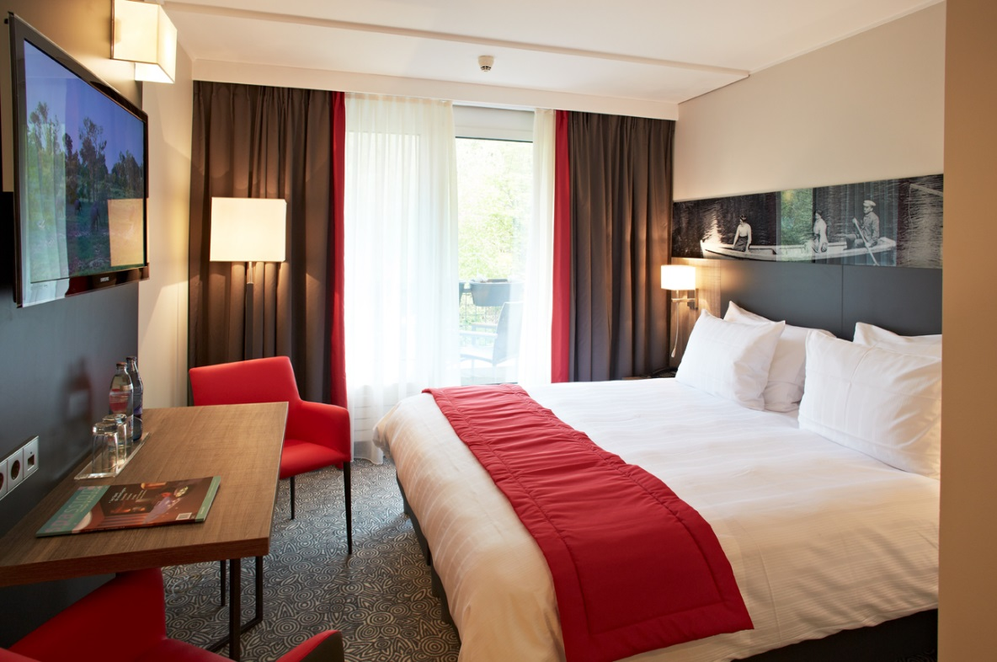
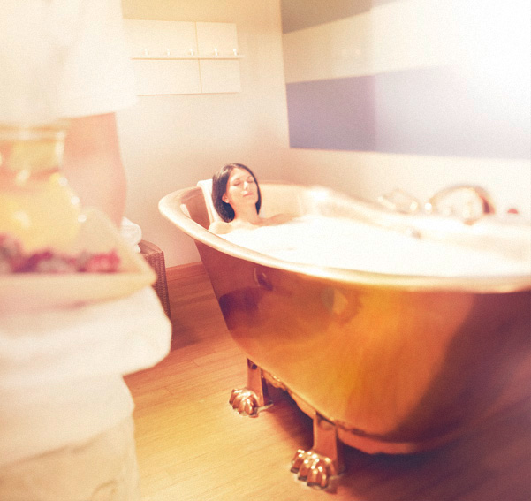
Elegant and fully refurbished spa & conference hotel with 108 rooms offering full range of modern amenities in a personal and contemporary atmosphere

Slide 9
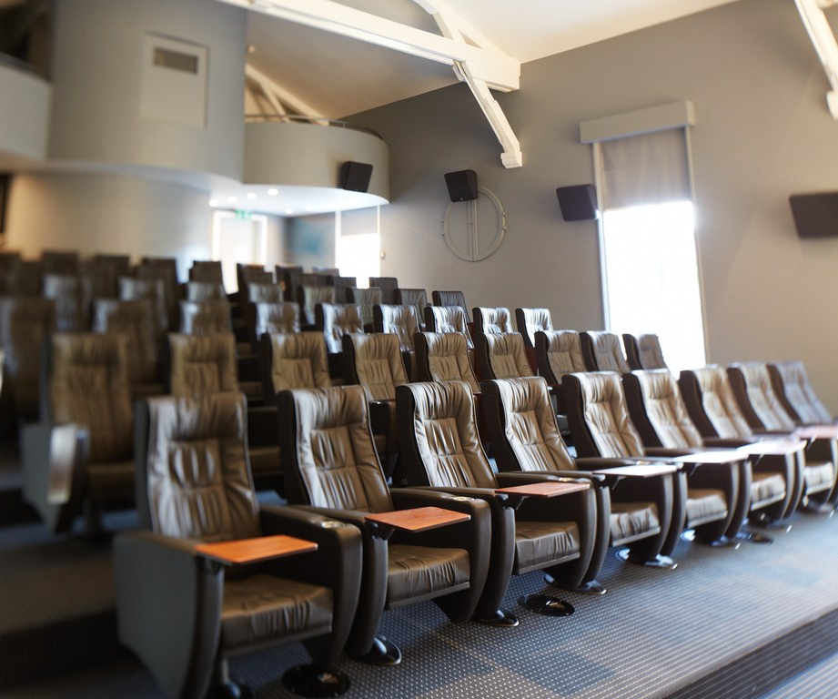
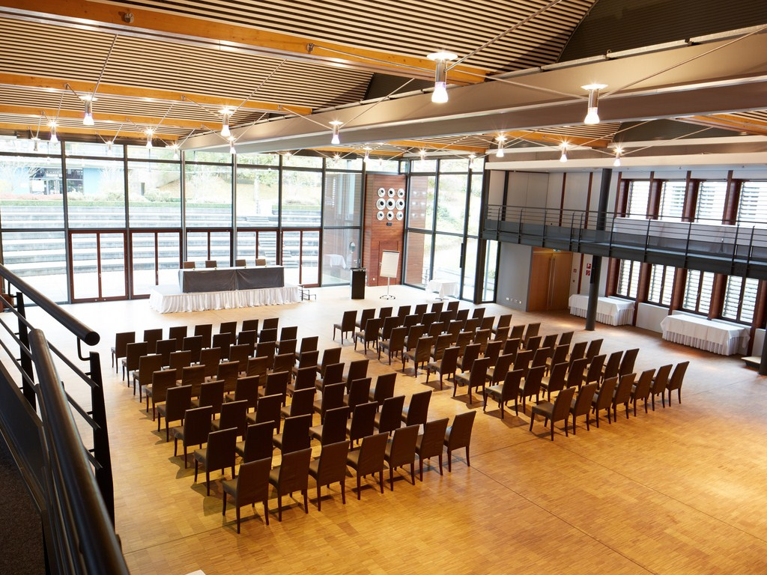
15 flexible function rooms filled with natural daylight, including state of the art technology, and perfectly adapted to meeting and banqueting events

Slide 10
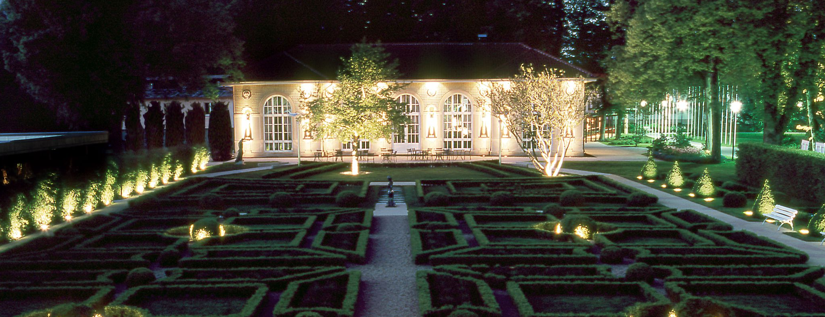
The historical building Orangerie facing a lushly landscaped French garden is complemented by creative solutions of Mr Gilles Goess, Chef of the Year 2015 by Gault & Millau Belux

